Slide 1
F20DL Data Mining and Machine Learning
Diana Bental
(with material from David Corne and slides from http://www.cs.waikato.ac.nz/ml/weka/book.html)

Slide 2
Lecture 4 Preparing Data for Input
We talked about Input
Concepts, Instances and Attributes
Practical issues - we already mentioned sparse data and denormalization (in the database sense of the word)
Now we cover some more practical issues
Look at a simple classification learning method (so we can use it) 1-Nearest Neighbour
Data preparation
Normalizing values
Discretization (binning)
Missing Values
inspection

Slide 3
The main issue for today
Dataset preparation
There are various things we can and should do to our dataset so that we make it easier, or indeed possible, to apply our chosen machine learning method
E.g. we may want to apply the ID3 Decision Tree learning algorithm – but this only works with categorical data.
We may want to apply a Neural Network, but this needs the data to be all numeric, and for all values to be relatively small (e.g. between -1 and 1).
etc

Slide 4
Example: 1-NN classification
Almost the simplest possible classification method.
The `classifier’ is just the dataset itself
Predict the class of a new instance new by finding the instance c in the dataset that is closest to new, and predicting that it will have the same class value as c

Slide 5
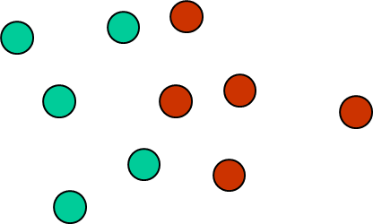
Visualisation of 1-NN
Suppose you have data with two numeric attributes and one class attribute , which is either red or green. We can treat the data as 2D points, coloured by the class. Suppose this is the pre-classified dataset:

Slide 6

Visualisation of 1-NN
Suppose you have data with two numeric attirbutes and one class attribute, which is either red or green. We can treat the data as 2D points, coloured by the class. Suppose this is the pre-classified dataset:
A new unclassified instance comes along – what is its class?

Slide 7
But life is often more interesting (and harder)
Just an aside to point out that, in many interesting and important classification problems, the situation is more like this:

Slide 8
A bit of notation
A dataset has N instances (records) {R₁,R₂,…,R_{N}},
… each of which has F attributes {A₁,A₂,…,A_{F}}.
Attribute A_{F} is the class attribute – the one we want to predict.
v(i,j) is the value of attribute A_{j} in record R_{i}
_{So, for example, what is}
Notes:
Sum for all instances of sum for all attributes except the class attribute
F is going from Attribute 1 to Attribute F-1 – so that is all attributes except the Class attribute
I is going from Instance 1 to N
Summing up all the Values as we go
Sum of all the values in the dataset except the class attribute

Slide 9
How to work out distance between two instances?
Depends on the data, and on your common sense. Let’s say we are only dealing with numeric data. One way to work out distance is the SSD (sum-squared distance)
If you have two records a and b, then the distance between them can be given by:
Just add up the squared differences of the fields, omitting the class field
Why don’t I take the square root of this?
Notes:
Take the difference between attributes – square it (makes it positive) – and repeat for each attribute and add them up
The more attributes are different for two intances, and the bigger the differences are, the bigger the sum
Taking the square root would make terms that are very far away from each other seem less important, and makes small differences seem more important

Slide 10
Scaling, Data Normalisation and Discretization
So now… we will learn these things:
Ways to do normalisation and scaling (which may be necessary or sensible, depending on how the data were generated, and on what DM/ML methods you want to use)
Ways to do discretization (for turning numeric fields into categorical fields)

Slide 11
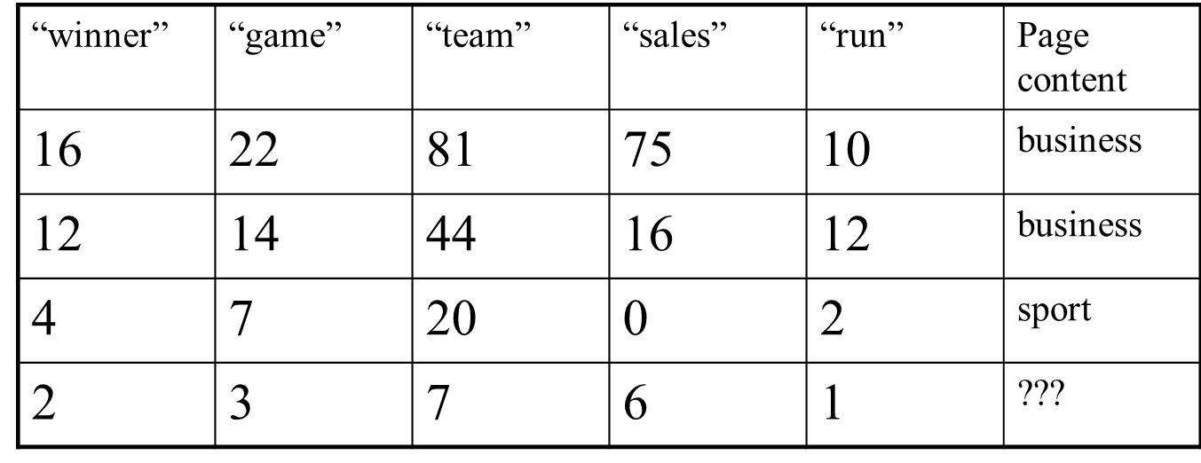
Data Normalisation
You have data about word-counts for specific words on web pages. You want to predict whether the page is about sport or business.
What category would 1-NN predict?
Notes:
Using nearest neighbour
Row 1. (16-2)**2 + (22-3)**2 + (81-7)**2 + (75-6)**2 +(10-1)**2 =~ 10 000
Row 2. (12-2)**2 + (14-3)**2 + (44-7)**2 +(16-6)**2 + (12-1)**2 =~1 800
Row 3. (4-2)**2 + (7-3)**2 + (20-7) **2 + (0-6)**2 +(2-1)**2 = 198
So prediction is SPORT – but is that right?

Slide 12
Data Normalisation
The closest record to the 4th is the 3rd, so it would be predicted to be sport. But this is probably wrong. Why?
Notes:
2 is closest to 4, 3 to 7, 7 to 20, etc – so we predict 4
But if we look at the proportions, we talk a lot about sales and the sport one doesn’t mention sales at all.
The problem is probably that the first two articles are simply much longer than the second two, so every word occurs more often.
We need to look at the proportion of words.

Slide 13
Data Normalisation
The closest record to the 4th is the 3rd, so it would be predicted to be sport. But this is probably wrong. Why?
Could we pre-process the data to help ML?

Slide 14
(1) Instance Normalisation
In these data, the sensible thing to do is transform each record so that it is normalised by the total number of words. This makes them more comparable, each providing a “fingerprint” in terms of the relative proportions of the probe words.
Sometimes this is necessary, sometimes it is useful – it takes common sense.

Slide 15
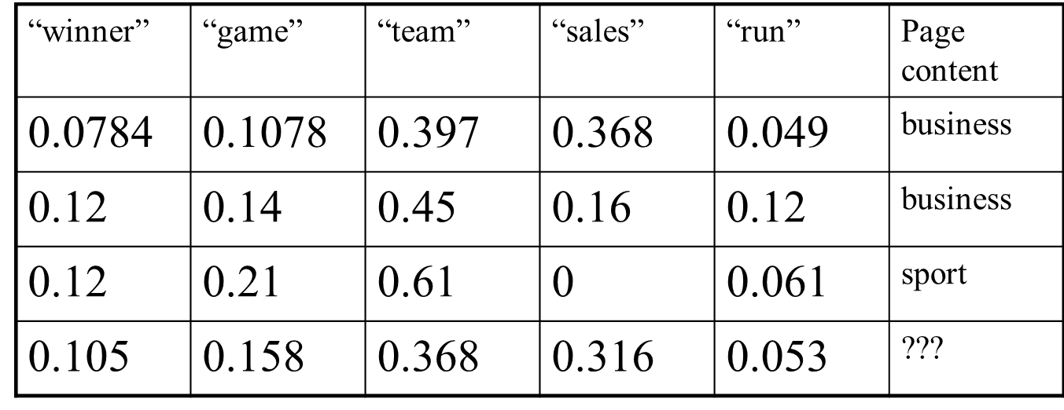
(1) Instance normalised version
Scale each row so the numeric fields add up to 1
1-NN now shows that record 4 is closer to 1 and 2
Notes:
Divide by the total number of words in each row
Row 1 divide by 204
Row 2 divide by 98
Row 3 divide by 33
Row 4 divide by 19

Slide 16
(1) Instance Normalisation
Using the notation in slide 5 – given a dataset of N numeric fields, how would you represent instance normalization of record r ?
Notes:
Answer: For record r and attribute a with value $v\left(r,a\right)$ , where N is the number of attributes:
$$v_{new}\left(r,a\right)= \frac{v(r, a)}{\sum_{j=1}^{N−1}{v(r, j)}}$$
NB: Sum of the attributes in the row:
$$\sum_{j=1}^{N−1}{v(r, j)}$$

Slide 17
(2) Attribute Min-Max normalisation
Min-max is attribute normalisation, done separately for each attribute (column)
For each numeric attribute, scale it so that each value is in a specific range [a, b]. E.g. usually [0,1], sometimes [-1, 1], etc]
To scale from 0-1
min(i) is the smallest value of attribute i in the dataset; max(i) is the largest; and range(i) is max(i) – min(i)
Notes:
Instance normalisation is done across each row (record/instance)
Previous example – all attributes were the same (numbers of words) and on the same scale
Min-max is done across columns (attributes)
Makes different attributes comparable

Slide 18
(2) When min-max normalisation might be useful
 | Height (mm) | Weight (kg) | Strength | Game score
1 | 1856 | 75 | 95 | 70
2 | 1502 | 56 | 101 | 82
3 | 1904 | 86 | 112 | 90
4 | 1775 | 61 | 110 | 90
5 | 1901 | 81 | 92 | ??
Which record is closest to record 5?
Is this a good predictor for game score?
Which attribute is most likely to predict the score?
Can min-max normalisation help?
Notes:
The variation in height (400 mm) is much bigger than Strength (20) (or weight 30) Just because it’s measured in mm
So if we do the nearest neighbour sums height will overwhelm the others and we’d probably expect a game score of 90 points like record 3
But is this right?
Some games – maybe… like basketball players. But is this right? What if this is a rowing game?
Scales everything
The variation in height (402mm) is much bigger than Strength (20) (or weight 30) Just because it’s measured in mm
Min height is 1502, max is 1904, range is 402

Slide 19
(2) When min-max normalisation might be useful
 | Height (mm) | Weight (kg) | Strength (kg) | Game score
1 | 0.88 | 0.63 | 0.15 | 70
2 |  |  |  | 82
3 | 1.00 | 0.63 | 1.0 | 90
4 |  |  |  | 90
5 | 0.99 | 0.83 | 0.0 | ??
Which record is closest to record 5?
Will this be a good predictor for game mark?
Which attribute is most likely to be important for predicting mark?
How does min-max normalisation help?
Notes:
Height: Range = max – min = 1904-1502 = 402
Weight: Range = max – min = 86-56 = 30
Strength : Range = max – min = 112-92 = 20
For each entry: New value = (Value – min) / Range
First row:
Height 1856 – 1502 = 354 ; 354/402 = 0.88
Weight 75-56 = 19 ; 19/30 = 0.63
Strength 95-92 = 3 ; 3/20 = 0.15
Suddenly we’re a lot closer to record 1 than record 3 (can do the sums for the other rows, and the Nearest Neighbour calculation)
Mention: Can also scale by mean and standard deviation – compute the mean and SD of the values; how many SD is each value from the mean? Z-normalisation, discussed in later lecture

Slide 20
Discretization
 | Height (mm) | Weight (kg) | Strength | Game score
1 | 1856 | 75 | 95 | 70
2 | 1502 | 56 | 101 | 82
3 | 1904 | 86 | 112 | 90
4 | 1775 | 61 | 110 | 90
5 | 1901 | 81 | 92 | ??
We can’t run the ID3 Decision Tree classifier on this data

Slide 21
Discretization
 | Height | Weight | Strength | Game score
1 | tall | heavy | medium | low
2 | short | light | medium | high
3 | tall | heavy | strong | high
4 | medium | medium | strong | high
5 | tall | heavy | medium | medium
We can run the ID3 decision tree algorithm on this data

Slide 22
Discretization
Discretization is simply a process that converts a numerical field into a class field.
How might you do this?

Slide 23
Binning: Equal Width Binning (EWB)
EWB(5), for example, means you discretize into 5 values, where each value has equal `width’.
If attribute values range from 0 to 100, then, then each bin has width 20. In the converted dataset, we can just label this bins 1,2,…,5, or we can use appropriate linguistic terms, such as:
{very low, low, medium, high, very high}
Notes:
A few data items at the extremes outliers may cause us to create extra bins that are nearly empty and have a few very few bins in the middle
e.g. number of letters we receive – mostly 0,1 or 2; suddenly receive 10 cards for a birthday
Skewed data isn’t handled well – most of the data is on one side

Slide 24
Binning: Equal Frequency Binning (EFB)
EFB(3), for example, means you discretize into 3 values, where each bin covers (roughly) the same amount of data.
So some bins are wider than others but all the same height
Notes:
Handles skews and outliers well

Slide 25
Binning
Example: customer ages
number of values
Equal width binning:
0-10
10-20
20-30
30-40
40-50
50-60
60-70
70-80
Equal freq binning:
0-22
22-31
48-55
62-80
38-44
32-38
44-48
55-62
Notes:
Bin widths the same, varied frequencies
Varied the bin widths to get the same number in each bin

Slide 26
Contrived Example for EWB(2)
Height (mm) | Weight (kg) | Strength (kg) | Game score
1856 | 75 | 95 | 70
1502 | 56 | 101 | 82
1904 | 86 | 112 | 90
1775 | 61 | 110 | 90
1901 | 81 | 92 | ??
Discretized, 2 equal width bins
Height | Weight | Strength | Game score
high | high | low | low
low | high | low | low
high | high | high | high
high | low | high | high
high | high | low | low
Notes:
Equal Width Binning with 2 values for each attribute
- Few low values for Height and Weight

Slide 27
Other discretization methods
There are others, which almost all differ from EWB and EFB in one respect: they use class value information to find bins that make good sense with regard to classification.
Notes:
Classifying irises – setosas and versicolors If you have most iris setosas in one group of petal width 2-2.8cm and all the iris versicolors are 3-4cm except one at 2.9cm
Might have a boundary at 2.9cm instead of 3cm

Slide 28

Get to know the data
Use simple visualisation tools e.g.
histograms for categorical data
graphs for numeric data – any obvious outliers?
scatter plots to reveal dependencies
Inspect a sample from a very large dataset
Data is often messy
Incomplete
Incorrect
Visualisation can pick up problems that may affect the results

Slide 29
Inaccurate values
Data was collected for other purposes
Comes from several places
Typographical errors in nominal values
Check for consistency
Typographical errors in numeric attributes
Check for outliers (extreme values)
Deliberate errors
E.g. wrong phone numbers, postcodes
Duplicates, out-of-of-date…

Slide 30
Missing values
Often, a dataset has missing values for some fields in some records. E.g. a certain blood test was not taken for some patients. A questionnaire response for some question was unreadable, etc…

Slide 31
Missing or Default Values
Missing values can have different meanings
E.g. Suppose the histogram of value types in mobile phone no. field is:

Slide 32
What does NULL mean?
A., This record is of someone who does not have a mobile phone?
B. This record is of someone who has a mobile phone, but chose not to supply the number?
C. This record is of someone who has a mobile phone, but who forgot to supply the number, or it was hard to decipher and recorded as NULL?
Maybe some are of type A and some are of type B and some are of type C. For some applications/analyses, we may wish to know the breakdown into types.
What about the All zero and All nine entries? Precisely the same can be said of them. Or, perhaps the protocols for recording the entries indicated NULL for type A, 0000000 for type B and 9999999 for type C.
The above relate to a quite simple form of semantic complexity – but what if someone uses this DB to estimate the proportion of people who have never had a mobile phone?

Slide 33
Cleaning via basic data analysis
Data Profiling: examine the instances to see how the attributes vary. E.g. Automatically generate a histogram of values for that attribute.
How does the histogram help us in finding problems in this case?
Notes:
Typo – bule

Slide 34
What problems does this analysis alert us to?
Notes:
Bulge of over 90s – maybe 99 has been used to indicate missing values? And -1?

Slide 35
Take away
Prepare data by scaling it and normalising it, and possibly dividing numeric data into categories (discretization)
Before you try to use a learning mechanism
Look at the data critically
Consider unusual data
And missing data

